Slide 1


Smart City Hackathon Rajkot 2020 - 21
Team ID : TM000079
Problem Type : Environment
Problem ID : SCHR033
Problem Statement : Plant a tree app.

Slide 2
Team Members & Mentors
Faculty Guide : Niraj Bhagvhandani
Assistant Professor at Atmiya University
Team Members:
1. Aghera Kevin Bipinbhai (kpatel9899s@gmail.com)
Contact No. : 8140169137 – MCA Semester -4, Atmiya University - Rajkot
2. Changela Savan Parsudbhai (savan.changela273@gmail.com)
Contact No. : 9537839403 – MCA Semester -4, Atmiya University - Rajkot
3. Garach Devang Bharatbhai (devanggarach@gmail.com)
Contact No. : 8460352525 – MCA Semester -4, Atmiya University - Rajkot
4. Panara Shivang Dilipbhai (shivangpanara@gmail.com)
Contat No. : 9106861734 – BE in Electronic & Communication Semester -6, Atmiya Institute of Information & Technology - Rajkot

Slide 3
Tools and Technologies used to solve the problem
Android Studio
MySQL
PHP
C Language
Arduino
NodeMCU
ESP8266
Sensors
Solenoid Valves, etc.

Slide 4
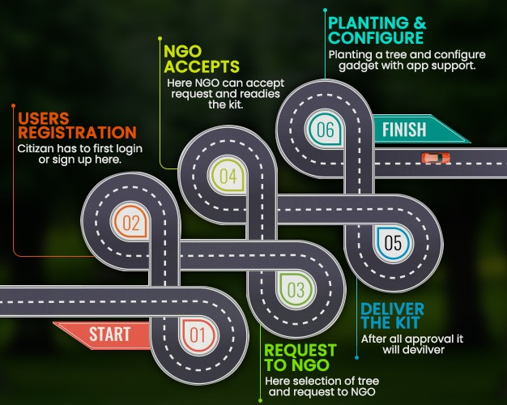
Road Map/Flow diagram of development

Slide 5
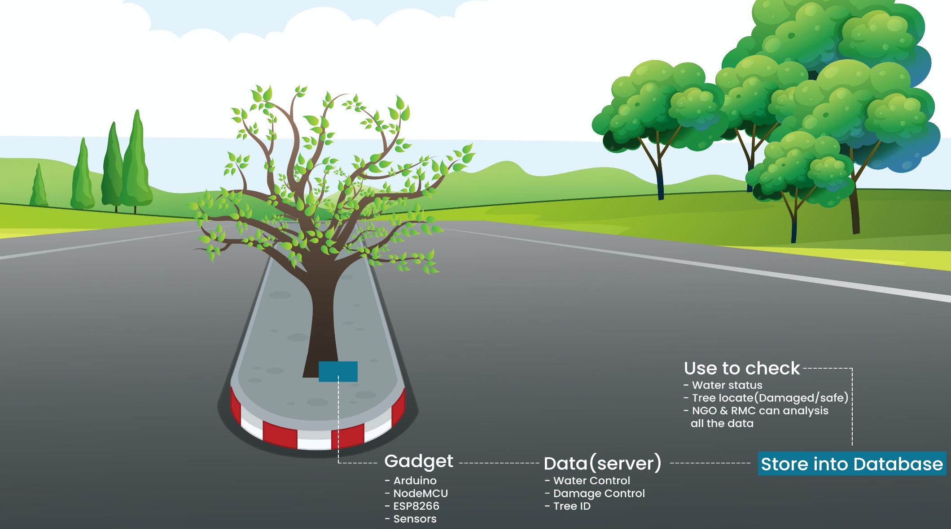
Pictorial Flow of diagram

Slide 6
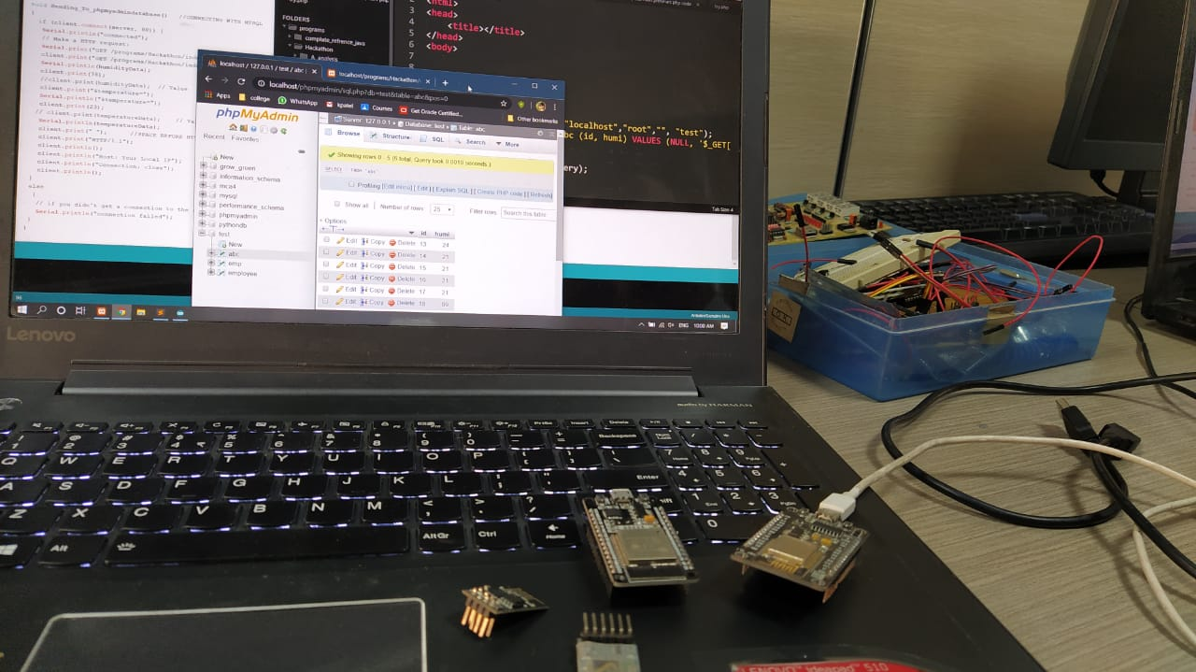
Screenshoot / Photo of practical with arduino

Slide 7
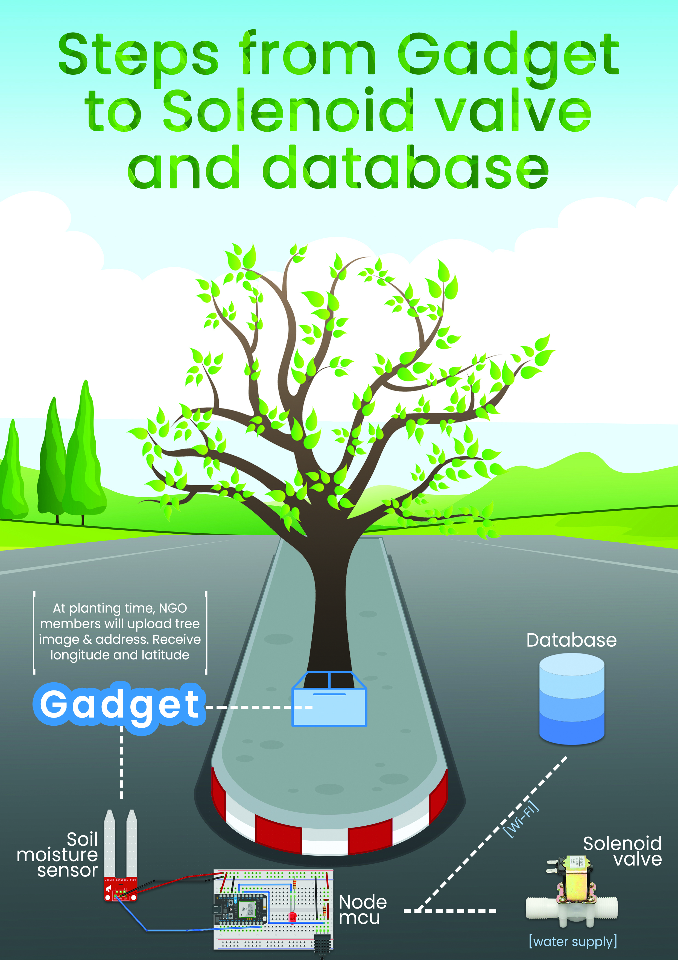

Slide 8
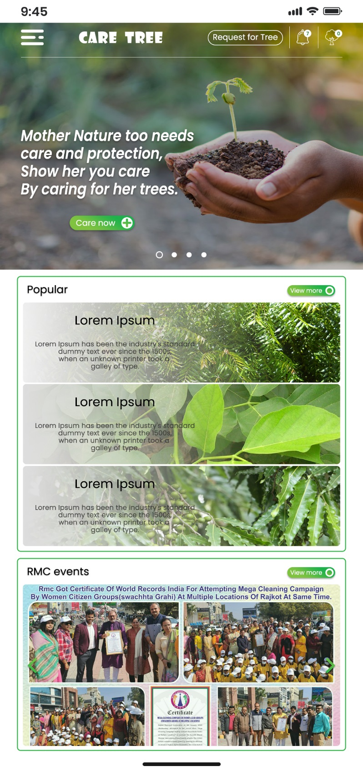
Screenshots

Slide 9
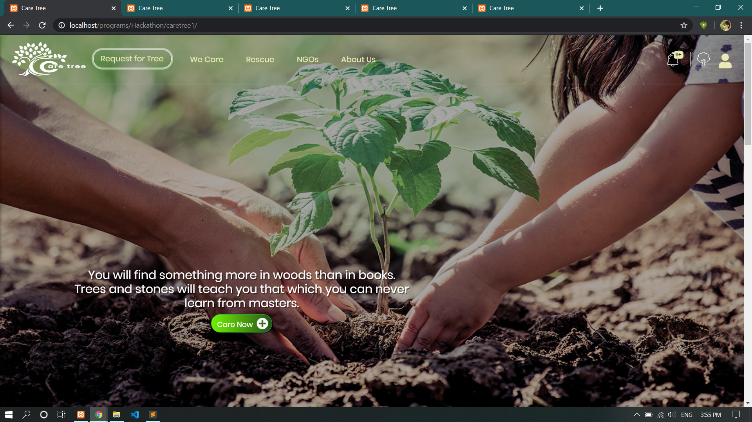

Slide 10
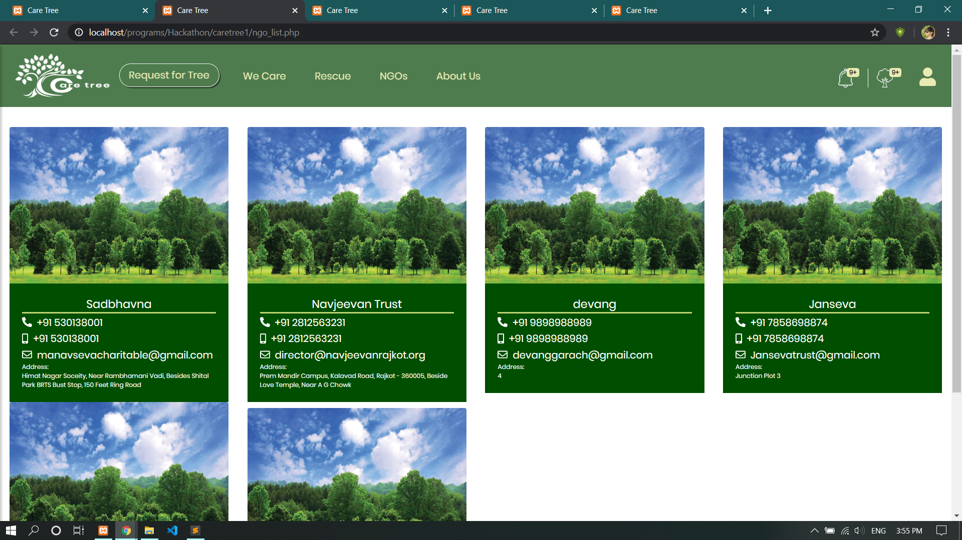

Slide 11
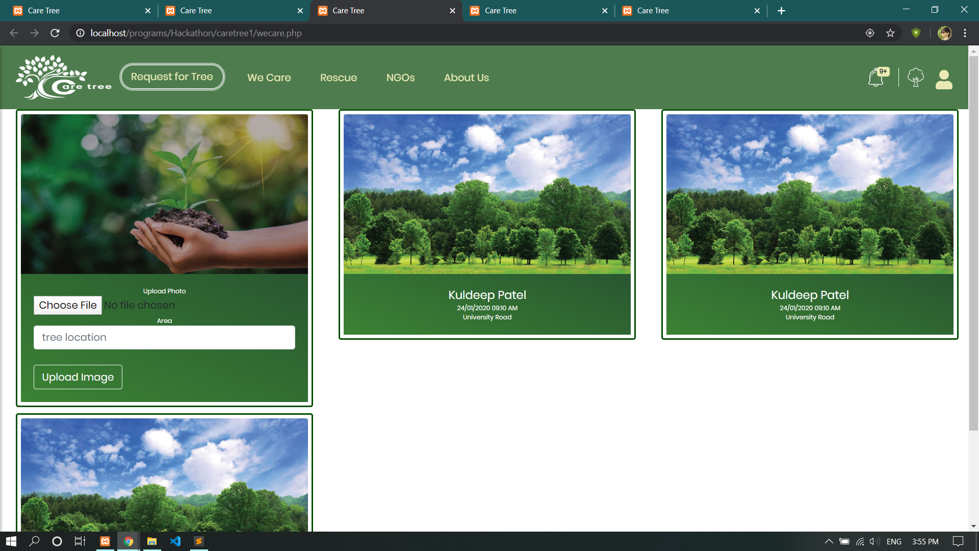

Slide 12
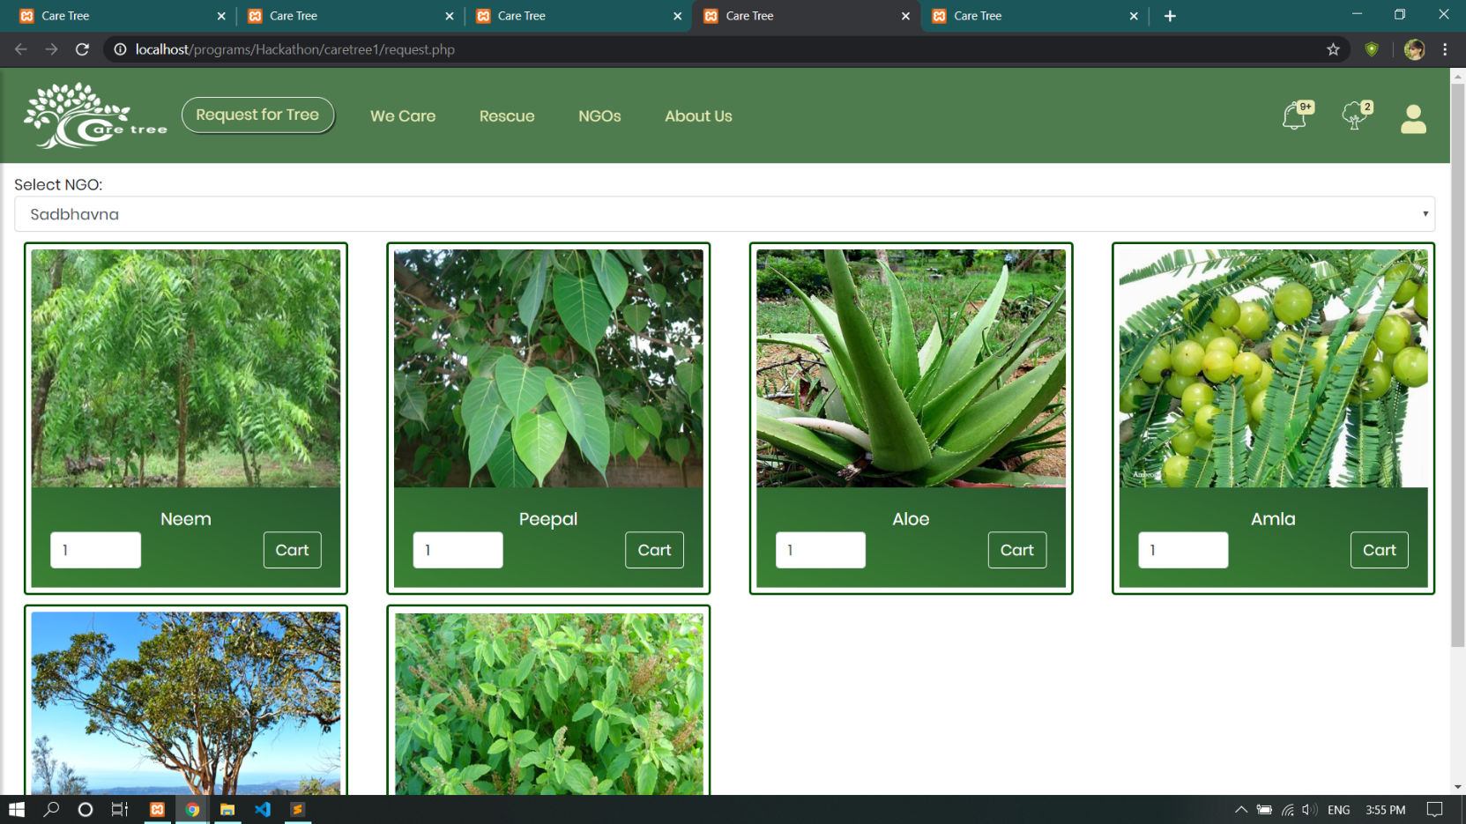

Slide 13
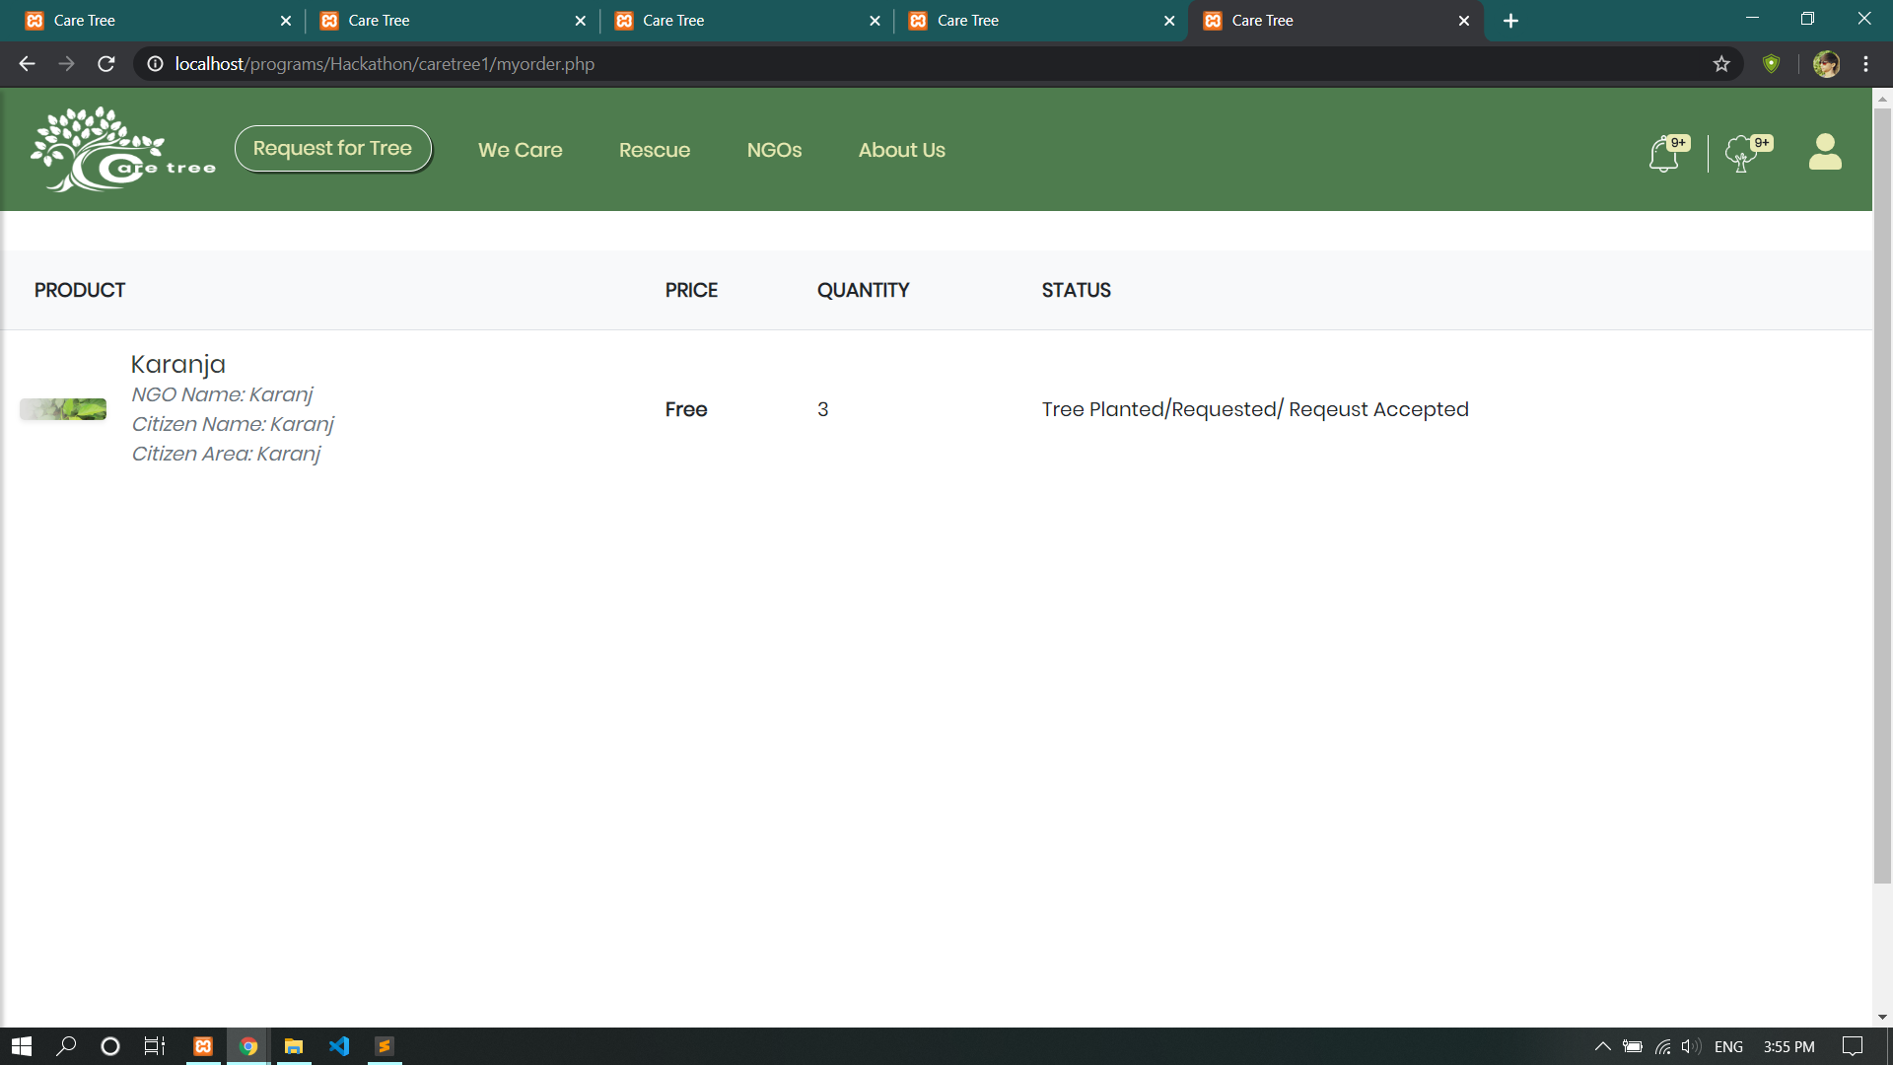

Slide 14
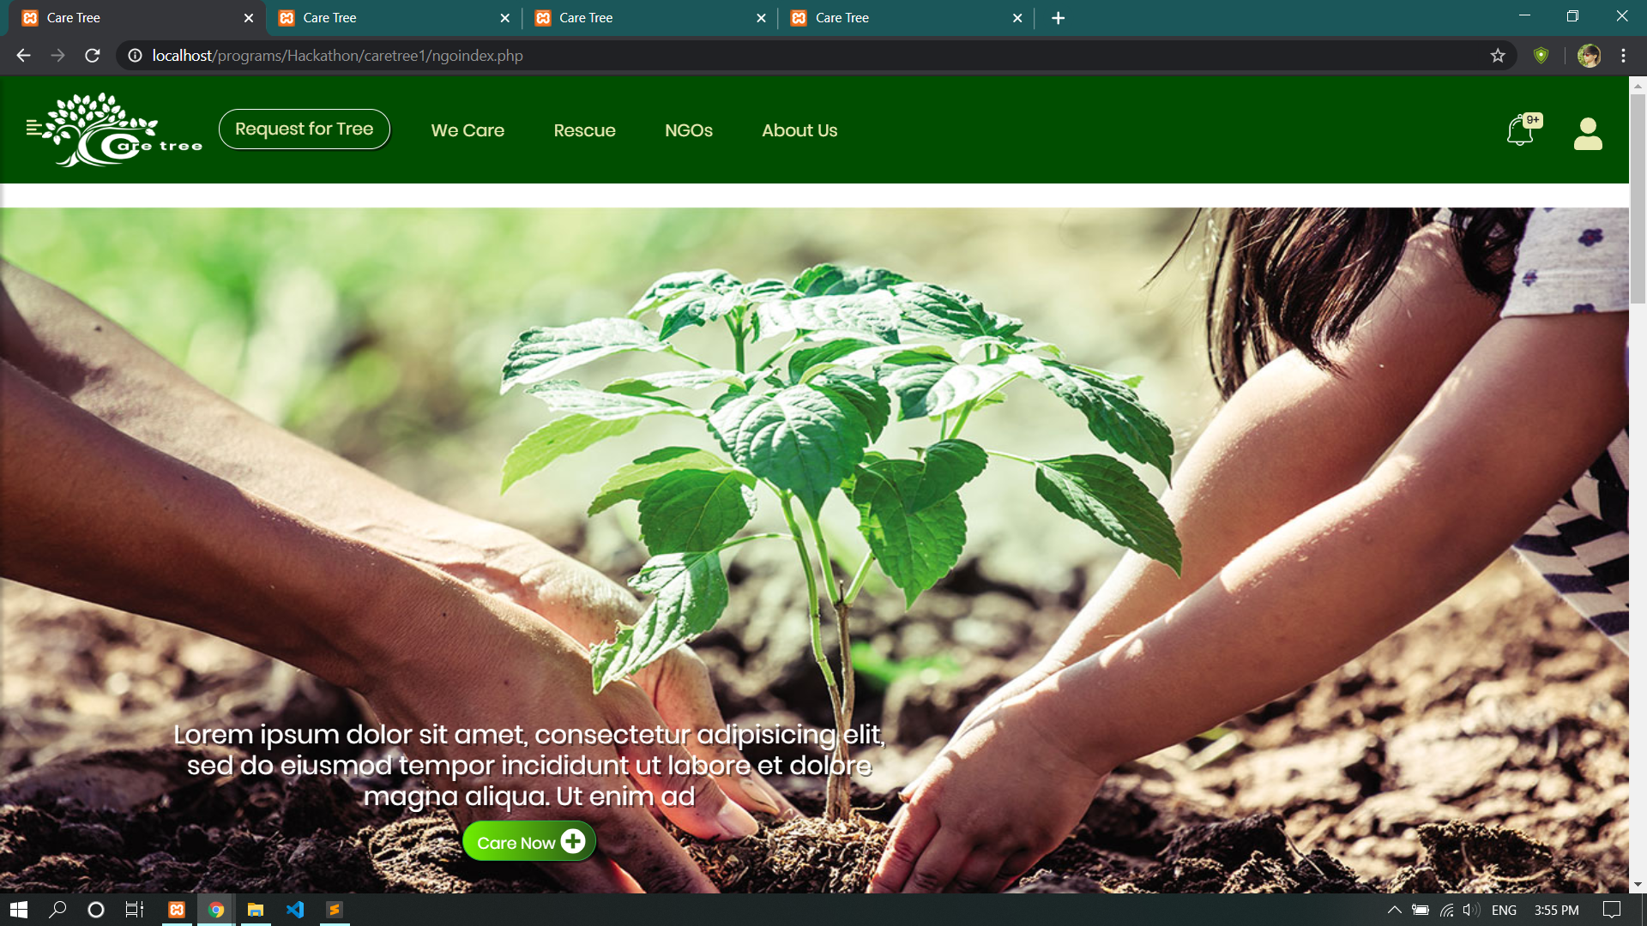

Slide 15
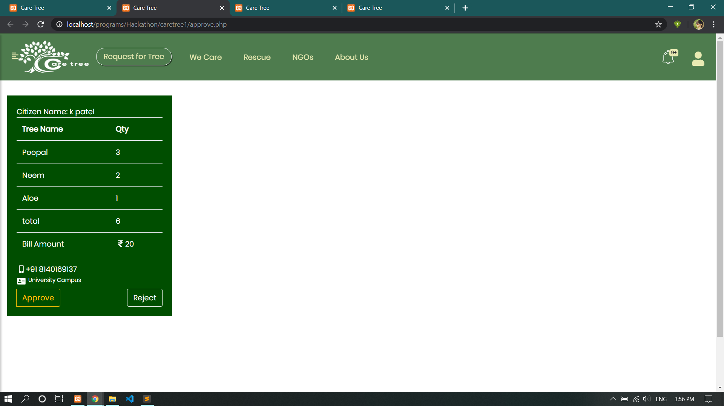

Slide 16
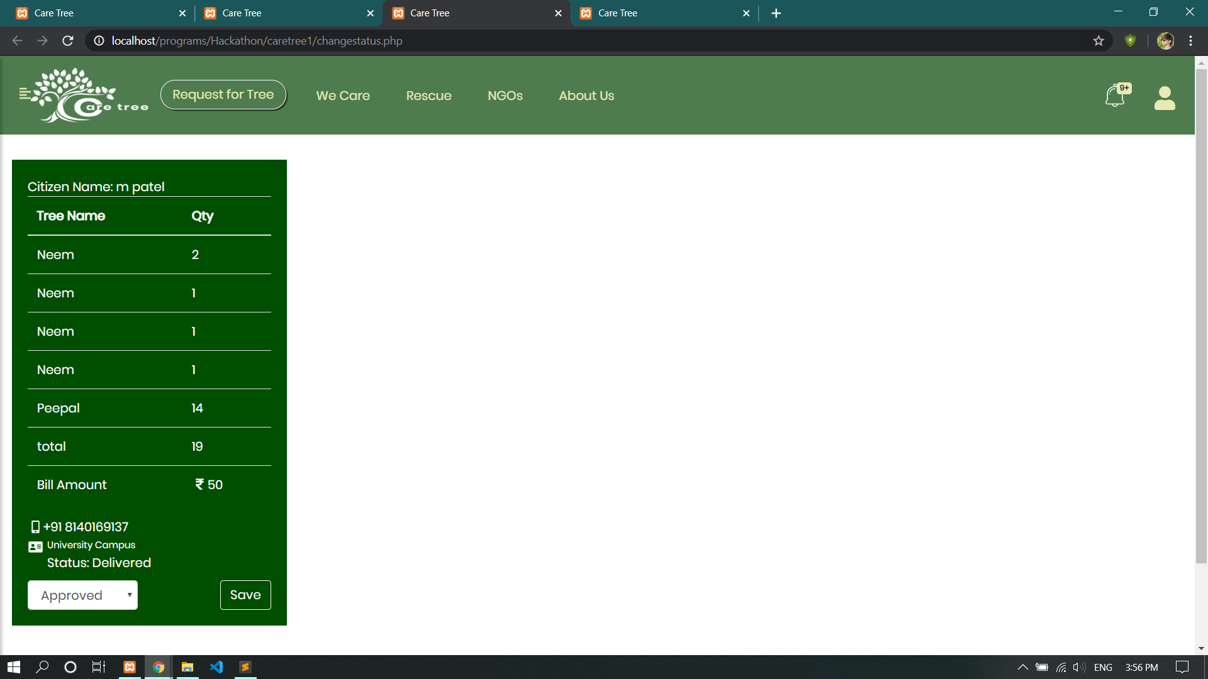

Slide 17
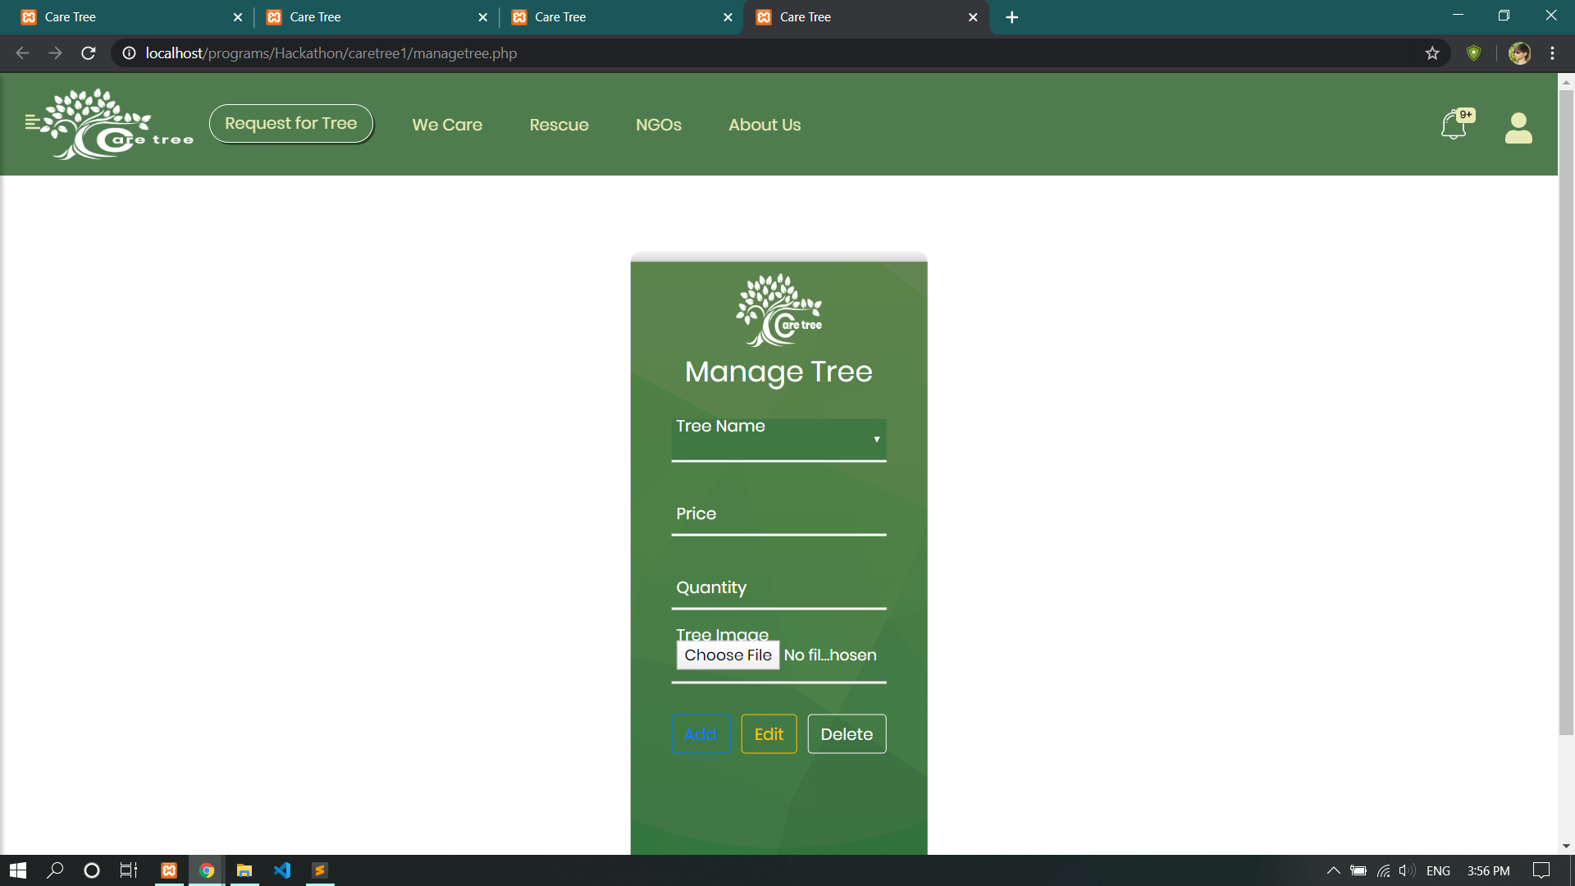

Slide 18
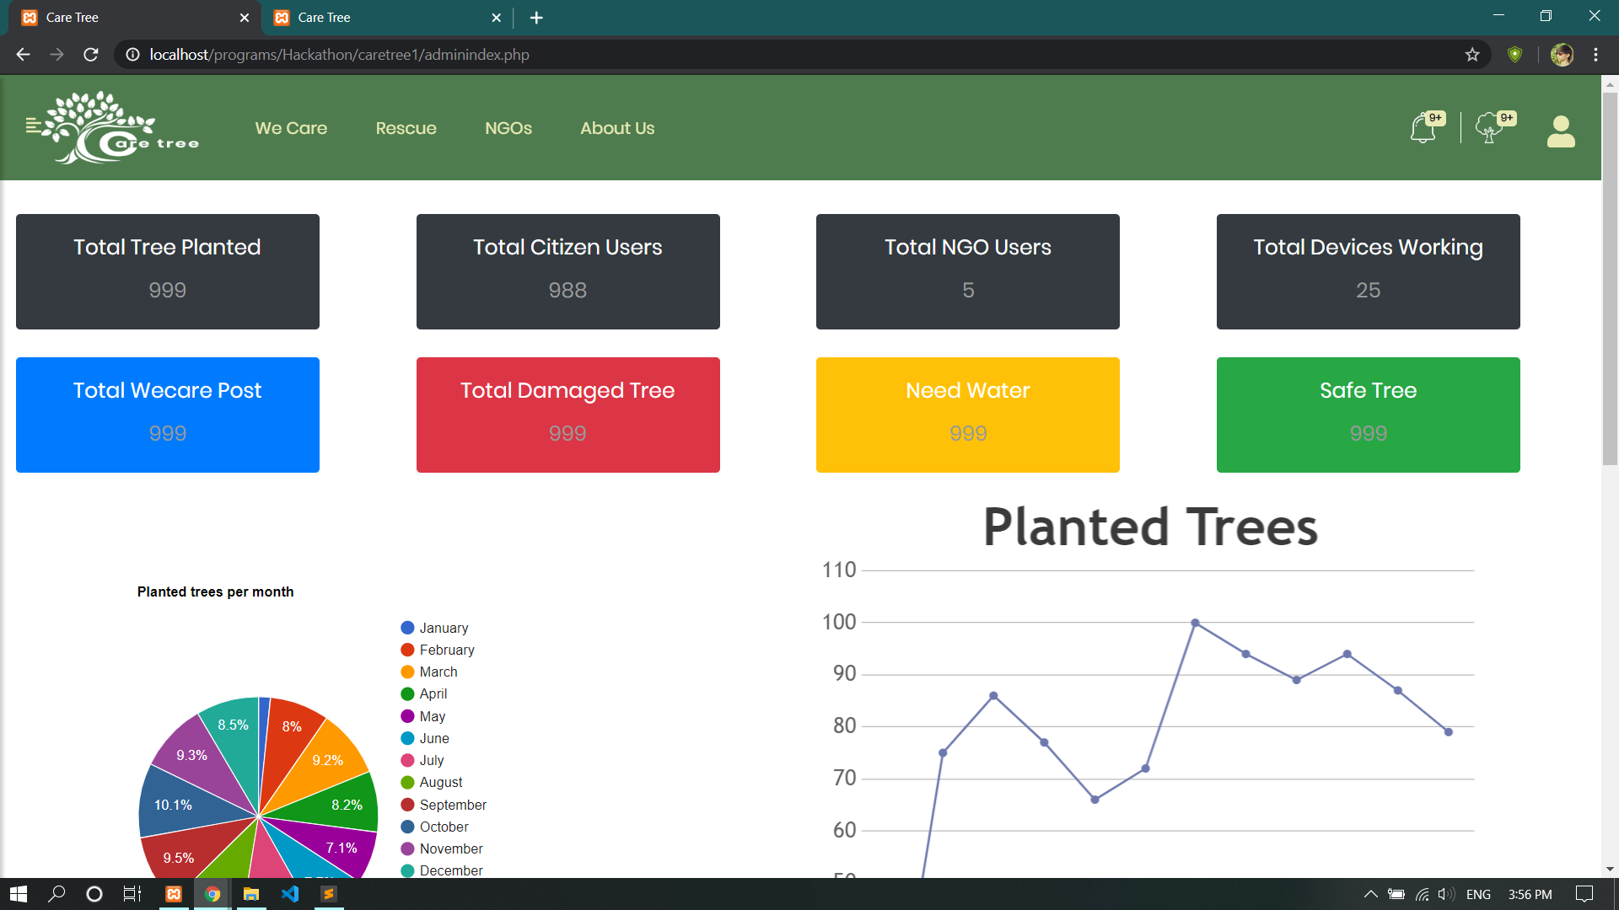

Slide 19
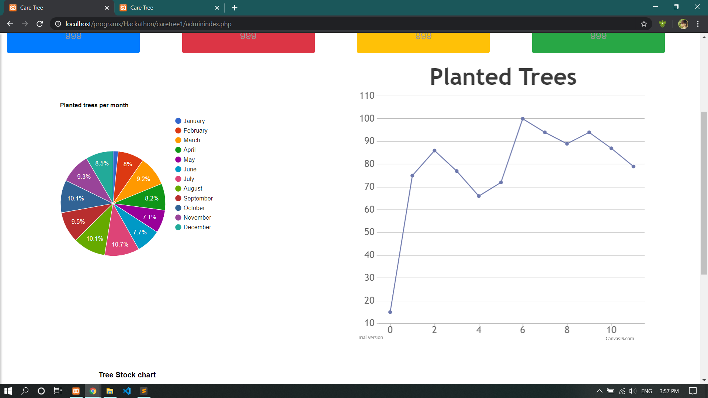

Slide 20
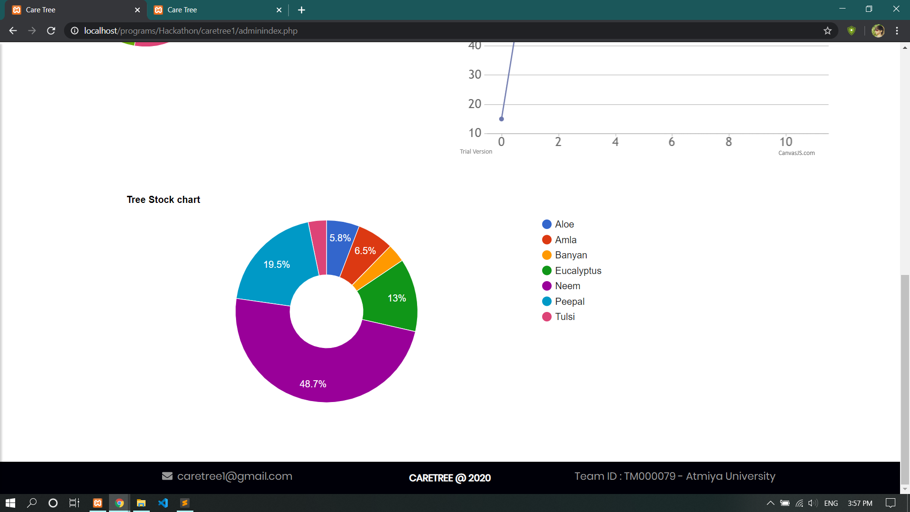

Slide 21
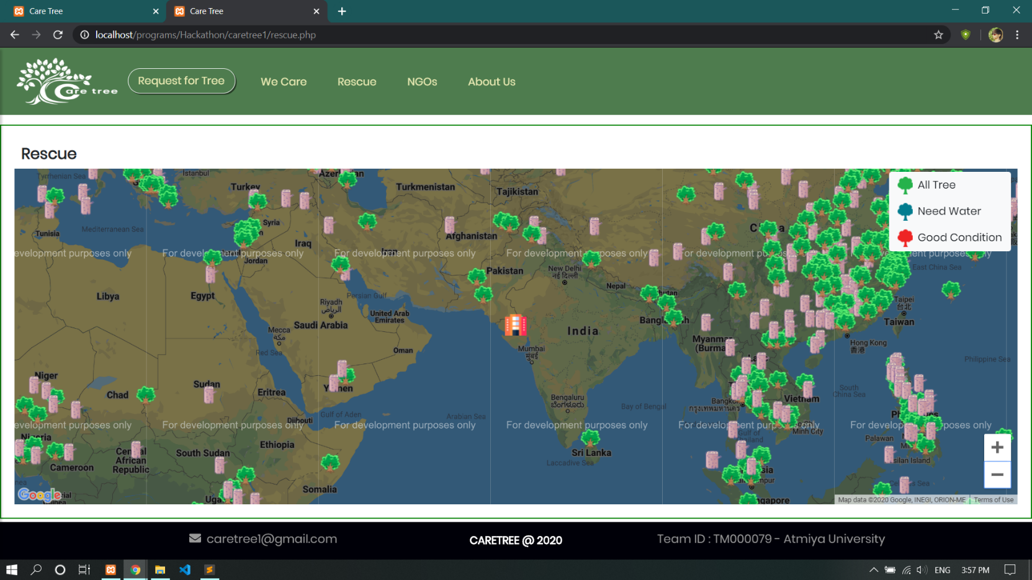

Slide 22
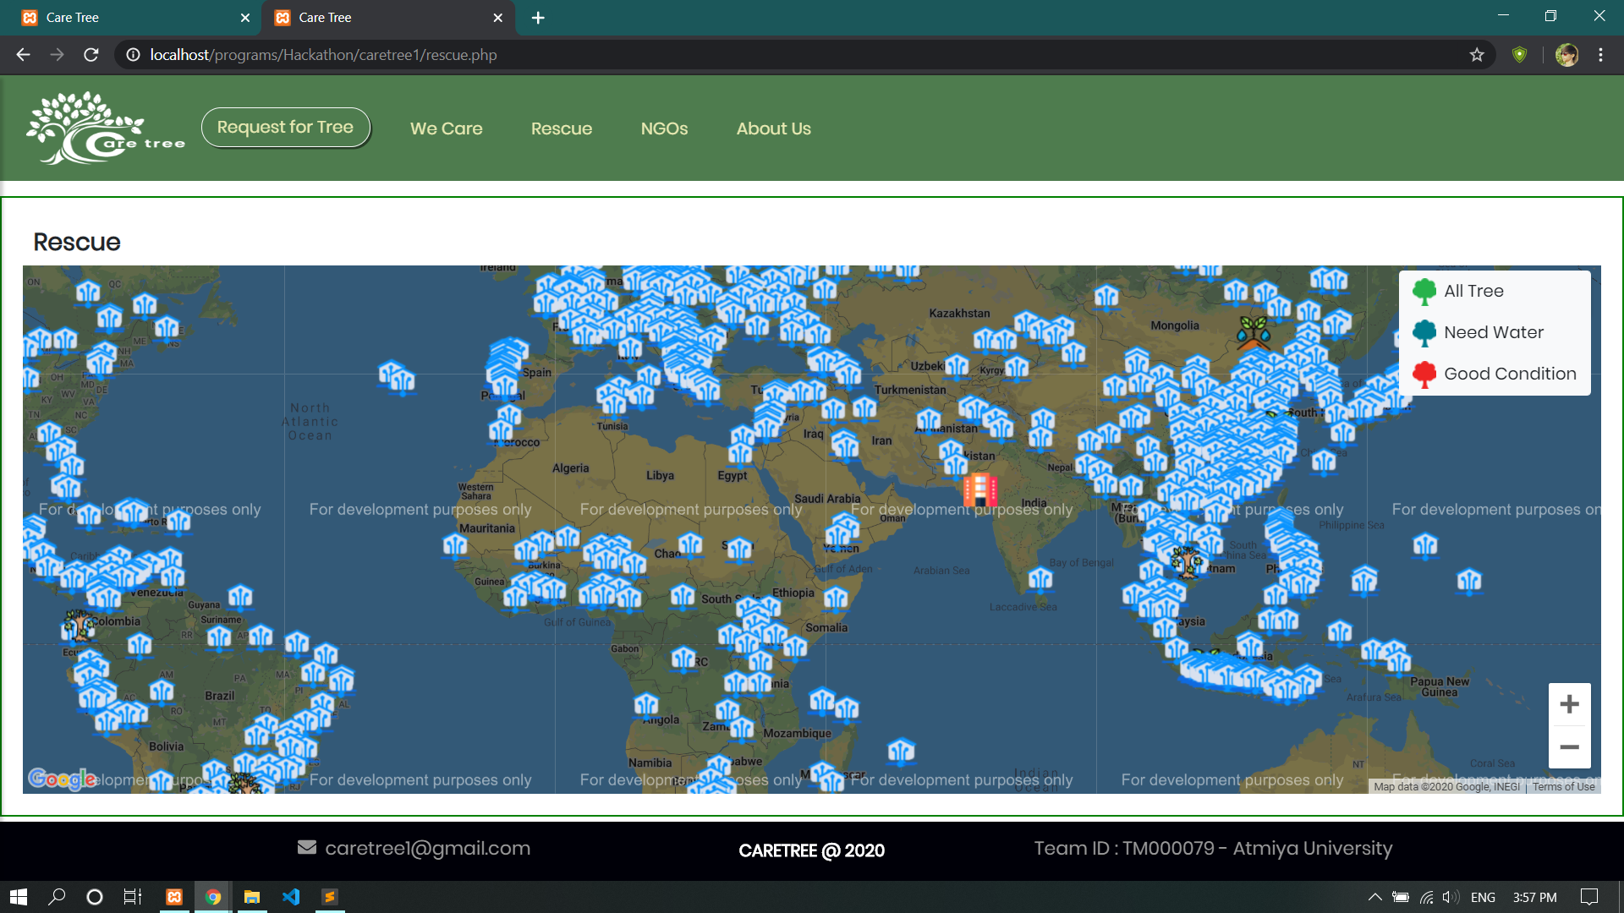

Slide 23
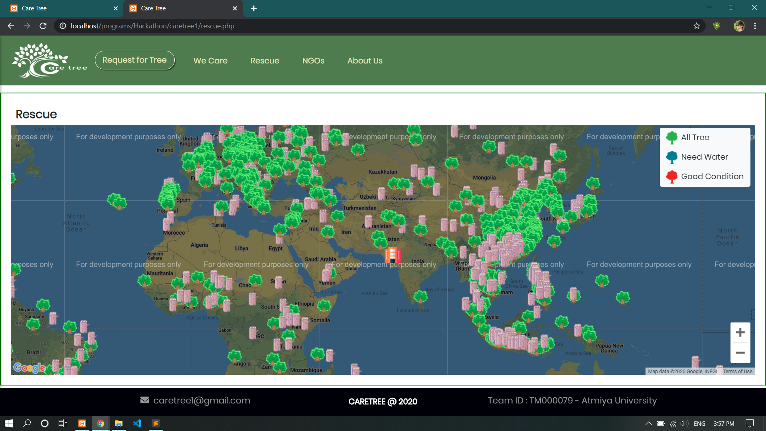

Slide 24
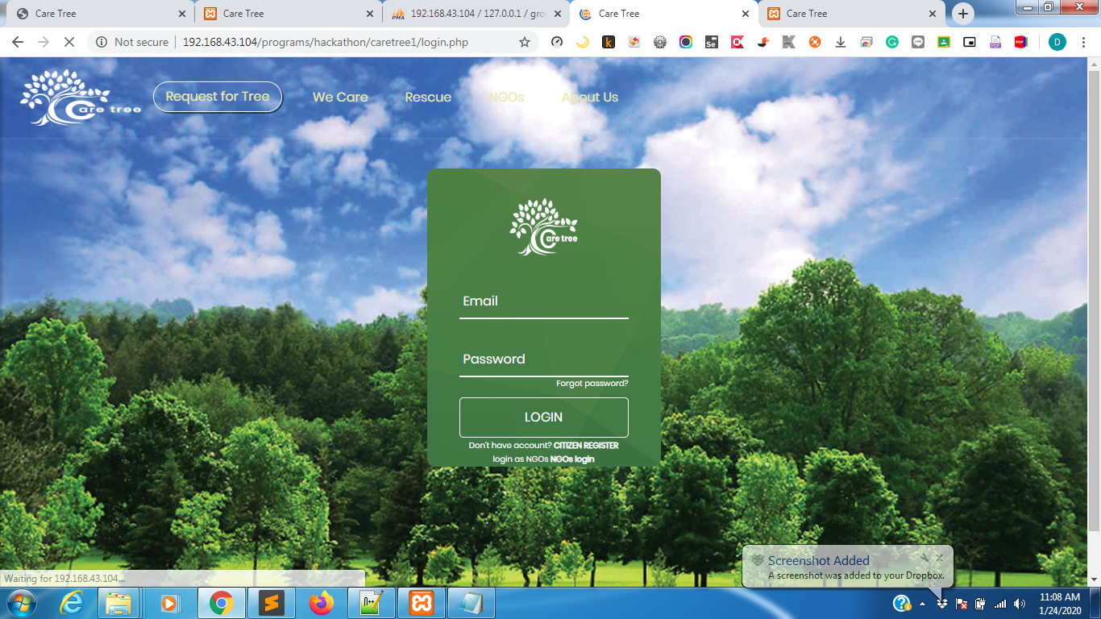

Slide 25
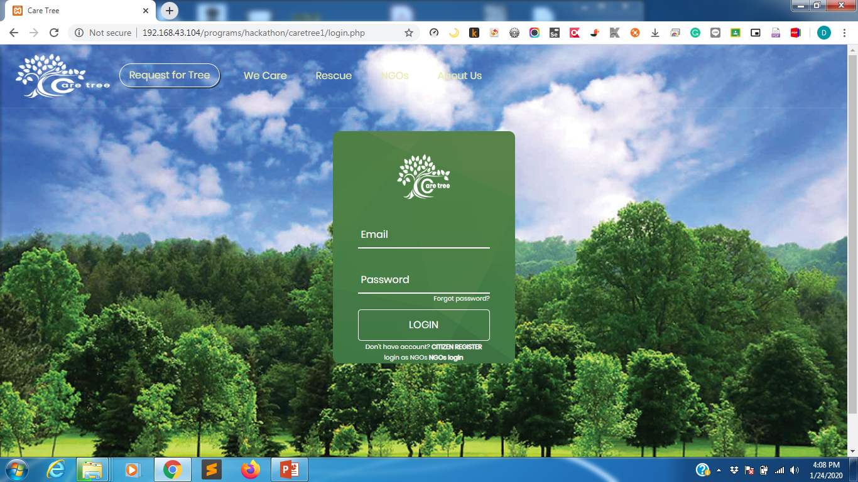

Slide 26
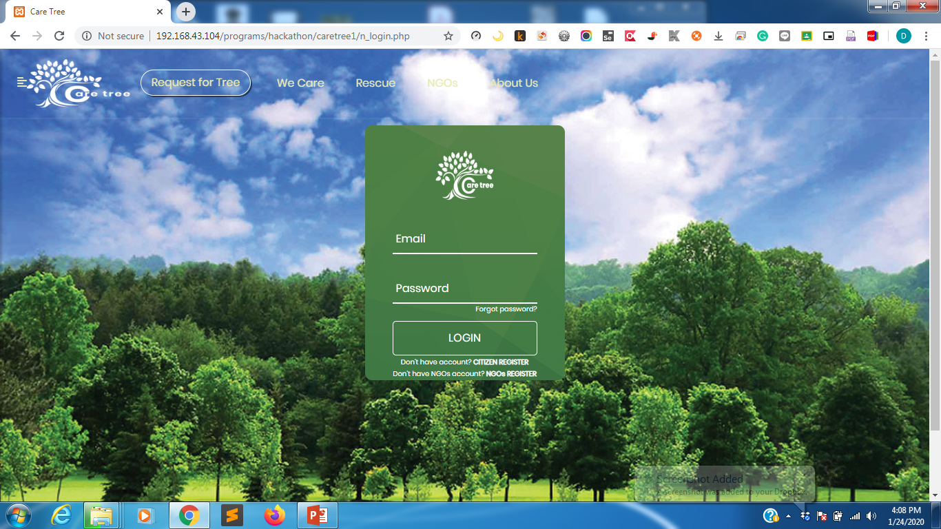

Slide 27
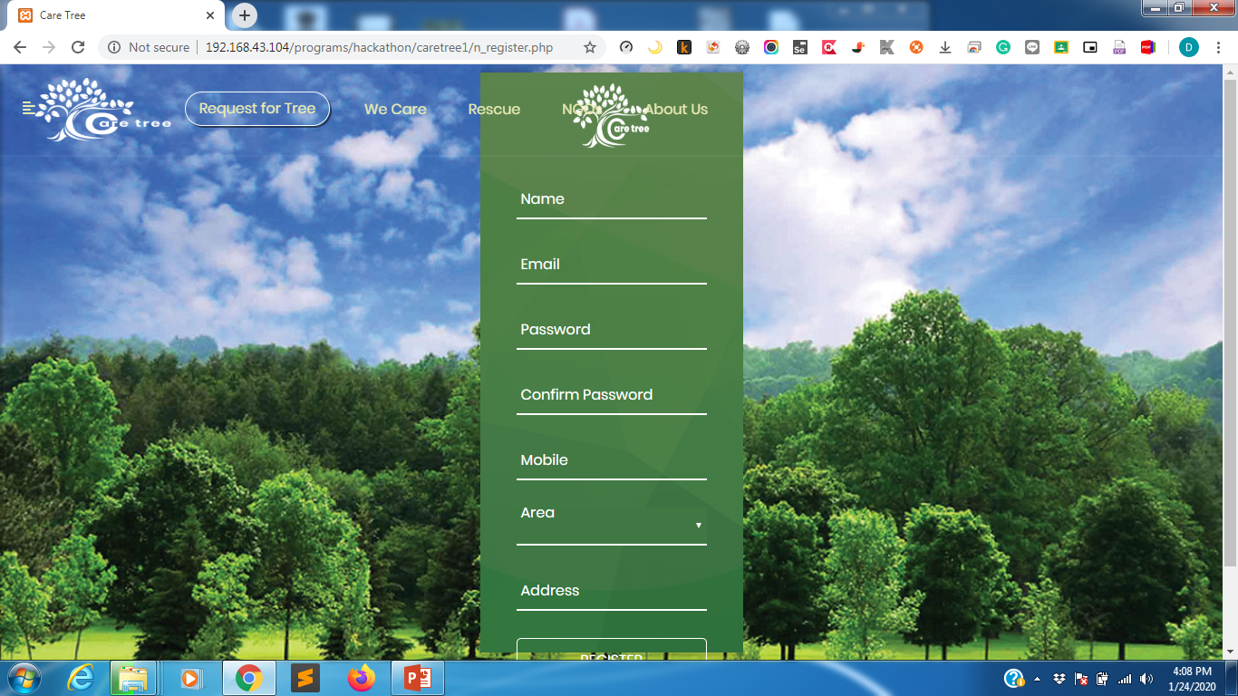

Slide 28
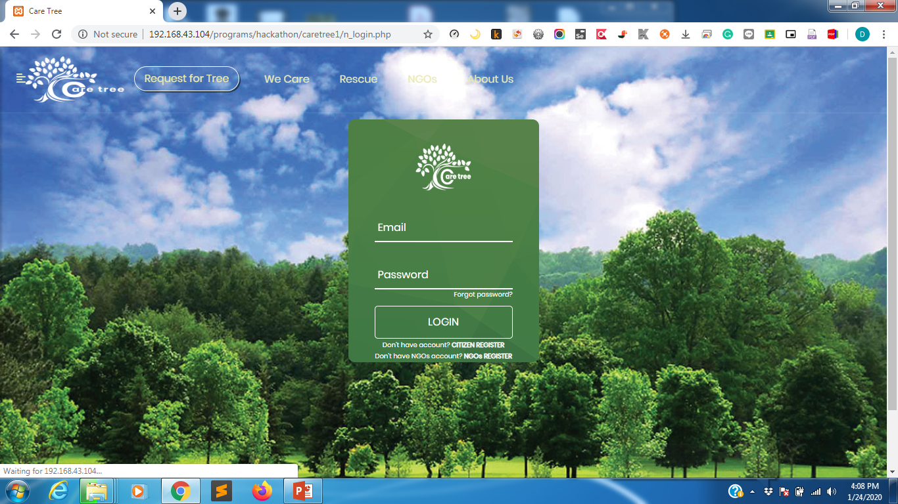

Slide 29
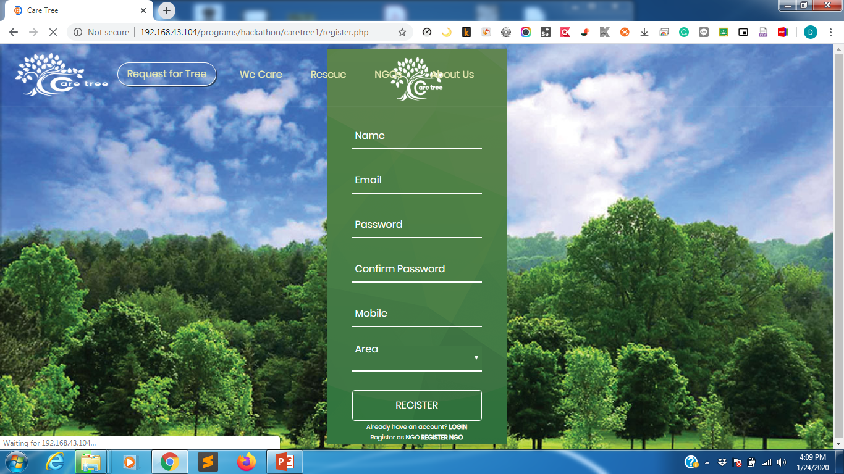

Slide 30
THANK YOU

